Slide 1

Alma AI Insights
A Live Demo and overall introduction
Yoel Kortick | H1 2026

Slide 2
Agenda
  Introduction
  Viewing the AI-Powered Insights
  Viewing the AI-Powered Insights – Example One
  Viewing the AI-Powered Insights – Example Two
  The Analytics Reports
  What's Going on Behind the Scenes
2

Slide 3
Introduction

Slide 4
Introduction
For additional information see also Alma AI Insights on the Ex Libris Knowledge Center.
As of the November 2025 release Alma includes an "AI Insights feature".
This feature periodically surfaces meaningful analytics-based insights within the platform.
These insights are generated by a Large Language Model (LLM) which analyzes predefined reports which have been curated by the Alma product team.

Slide 5
Introduction
Each insight is tailored to specific user roles and delivered as a notification. This allows users to view the insight and download the underlying report data.
At the current time, the AI Insights are implemented in English (even if the institution interface is in another language).
AI Insights aggregates information at the institution level. Therefore, insights will include information about the entire institution, not just a specific library.

Slide 6
Introduction
The initial insight types include the following:
  Loans in the Last 3 Months
    Appears for users with the "Circulation Desk Manager" role
  Electronic Collections Link Resolver Usage in the Last 3 Months
    Appears for users with the "Electronic Inventory Operator" role
  Purchase Requests in the Previous Year (coming soon)
    Appears for users with the "Purchasing Manager" role

Slide 7
Introduction
Institutions must opt in to activate the feature.
The opt-in
  Requires General System Administrator privileges
  Is done from "Configuration > General > AI Features > AI Usage Profile".
  Is at the institution level (not the level of a specific library).

Slide 8
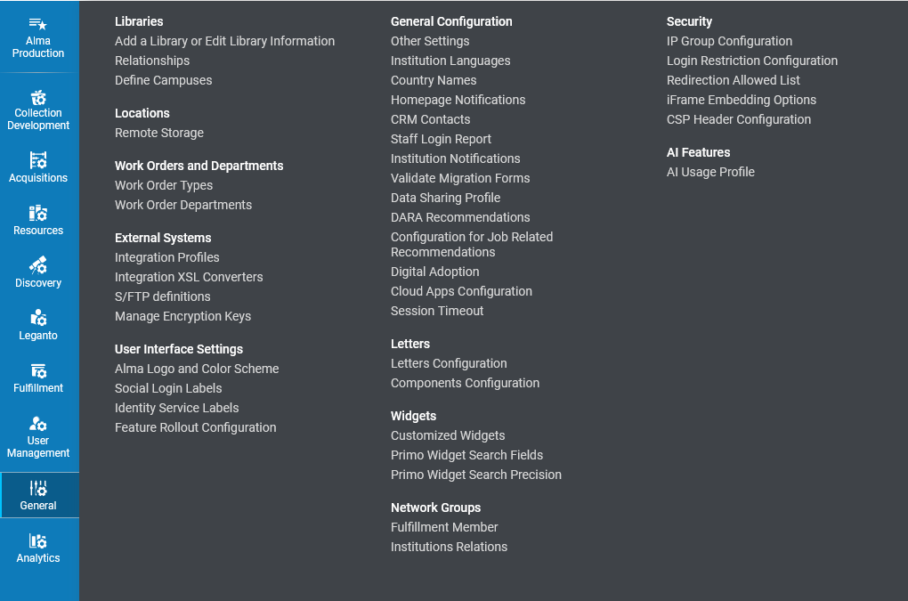
Introduction

Slide 9
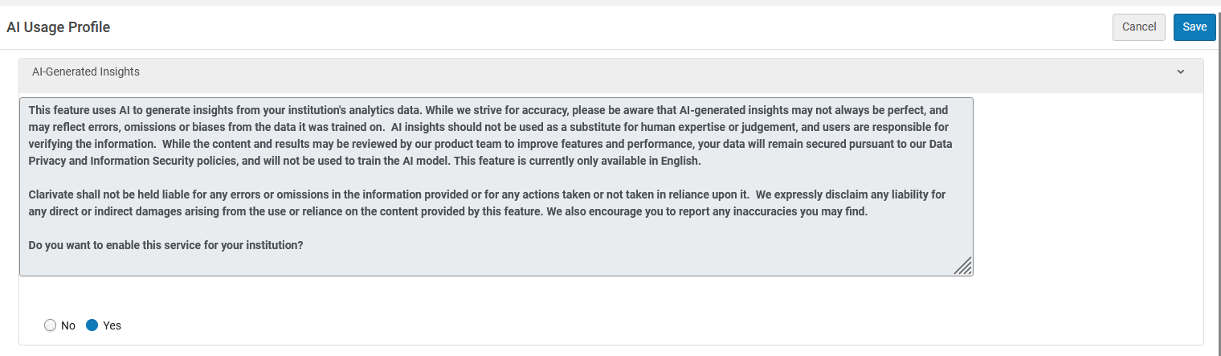
Introduction

Slide 10
Introduction
After that, the timing depends on the specific insight type.
The Insights rely on an internal API provided by OpenAI.
No personal data is included in the reports passed to the AI model, and no institutional data is shared with OpenAI at any point.
Since AI Insights are based on Analytics data, this feature is in Production and not in sandbox environments.

Slide 11
Viewing the AI-Powered Insights

Slide 12
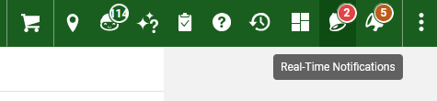
Viewing the AI-Powered Insights
The AI Powered insights can be viewed from the Real Time Notifications which appear in the upper toolbar of Alma.
Here for example, we see that there are two new Real Time Notifications.

Slide 13
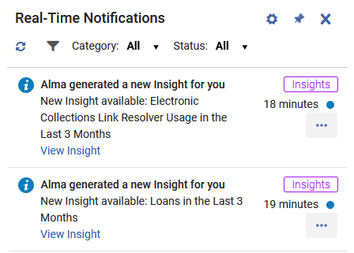
Viewing the AI-Powered Insights
Upon accessing the Real Time Notifications, we see that (in this case) there are two new AI-Powered Insights.

Slide 14
Viewing the AI-Powered Insights – Example One

Slide 15
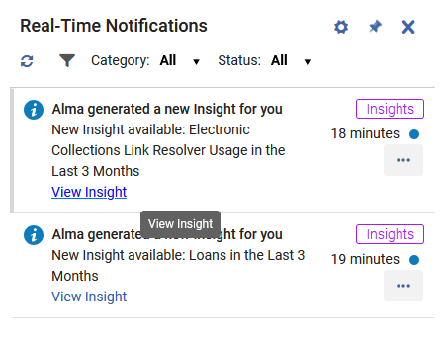
Viewing the AI-Powered Insights – Example One
We will now "View Insight" for "Electronic Collections Link Resolver Usage in the Last 3 Months"

Slide 16
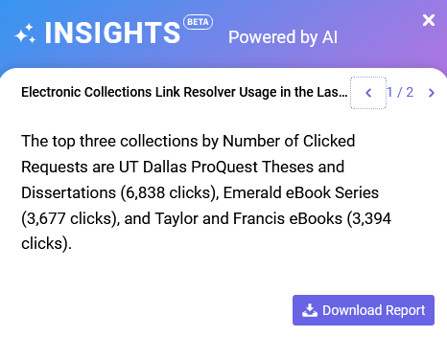
Viewing the AI-Powered Insights – Example One
The staff user is presented with page one of the insight

Slide 17
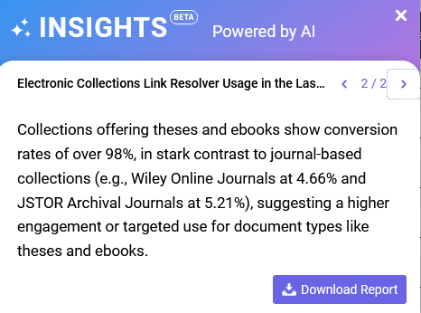
Viewing the AI-Powered Insights – Example One
The staff user has moved to page two of the insight

Slide 18
Viewing the AI-Powered Insights – Example One
The staff user has decided to Download Report

Slide 19

Viewing the AI-Powered Insights – Example One
The report is downloaded as a csv file

Slide 20
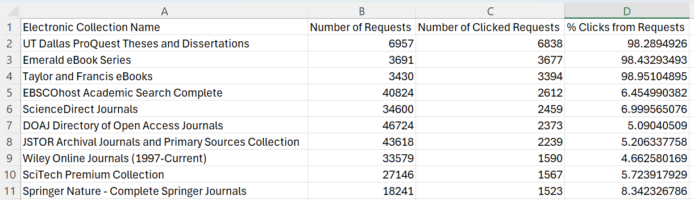
Viewing the AI-Powered Insights – Example One
The report is opened and viewed by the staff user

Slide 21
Viewing the AI-Powered Insights – Example Two

Slide 22
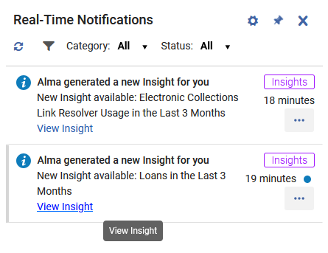
Viewing the AI-Powered Insights – Example Two
We will now "View Insight" for "Loans in the Last 3 Months"

Slide 23
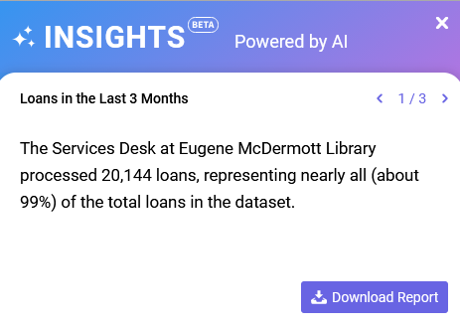
Viewing the AI-Powered Insights – Example Two
The staff user is presented with page one of the insight

Slide 24
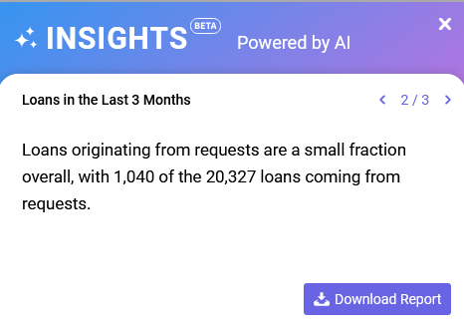
Viewing the AI-Powered Insights – Example Two
The staff user has moved to page two of the insight

Slide 25
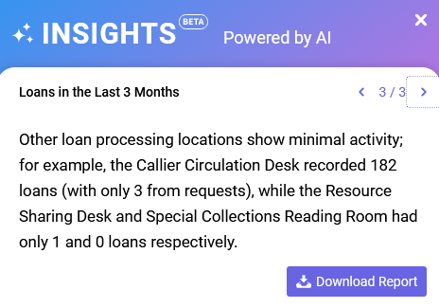
Viewing the AI-Powered Insights – Example Two
The staff user has moved to page three of the insight

Slide 26
Viewing the AI-Powered Insights – Example Two
The staff user has decided to Download Report

Slide 27

Viewing the AI-Powered Insights – Example Two
The report is downloaded as a csv file

Slide 28
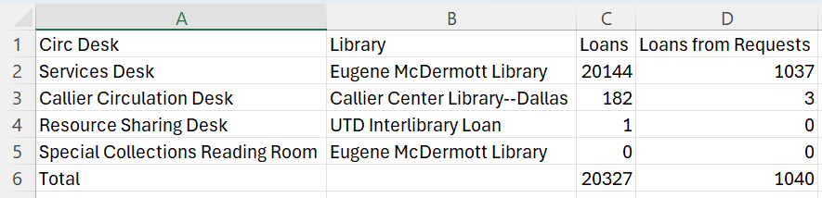
Viewing the AI-Powered Insights – Example Two
The report is opened and viewed by the staff user

Slide 29
The Analytics Reports

Slide 30
The Analytics Reports
As stated in the introduction, the insights are generated by a Large Language Model (LLM) which analyzes predefined reports which have been curated by the Alma product team.
In other words, the results of analytics reports are used by AI to create the insights.

Slide 31
The Analytics Reports
This is an insight from example one created by AI from the data of an analytics report

Slide 32
The Analytics Reports
This is an insight from example two created by AI from the data of an analytics report

Slide 33
The Analytics Reports
The Alma Analytics reports used to create AI-Powered Insights are taken from the DARA folder under the institutional folder of Alma Analytics.
  The full path is "/shared/Institution Name/Reports/DARA"
  The report names begin with text "Insights – "
A "clean" copy of the Alma Analytics reports used to create AI-Powered Insights are under the Alma folder
  The full path is "/shared/Alma/DARA"
  The report names begin with text "Insights – "

Slide 34
The Analytics Reports
The system works as follows:
  If the report is not present in the "/shared/Institution Name/Reports/DARA" folder, then it is copied by Alma from "/shared/Alma/DARA" and thus the default report will be used.
  In this way the institution can customize the report in their own institutional folder.
    If the report is in the institutional folder, then it is used from the institutional folder.
    If the report is not in the institutional folder, then it us used from the "/shared/Alma/DARA" folder and copied to the institutional folder.

Slide 35
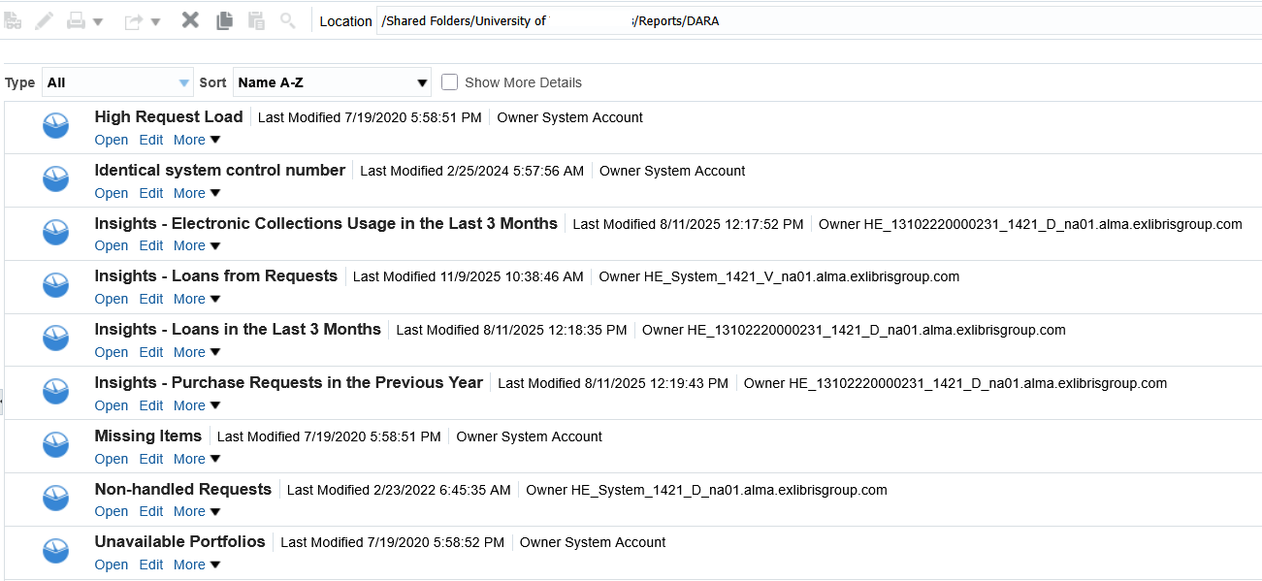
The Analytics Reports
The Alma Analytics reports used to create AI-Powered Insights are taken from the DARA folder under the institutional folder of Alma Analytics.

Slide 36
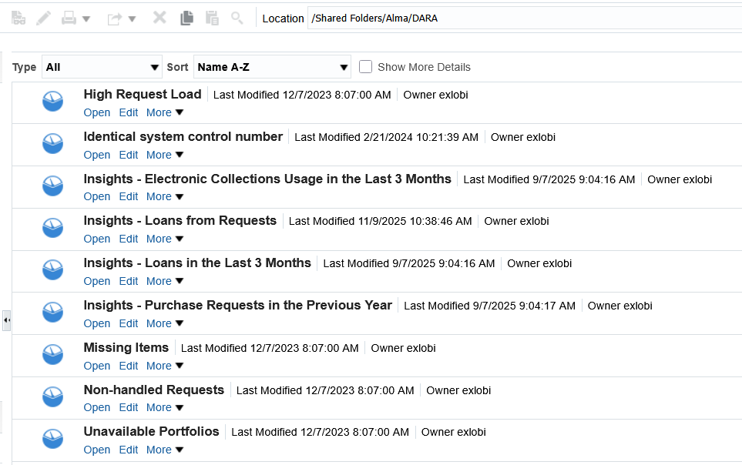
The Analytics Reports
The clean copy analytics reports used by the AI-Powered insights are in folder "Shared Folders/Alma/DARA" and begin with text "Insights – "

Slide 37
What's Going on Behind the Scenes

Slide 38
What's Going on Behind the Scenes
Behind the scenes there is a table "Insight Generation" (which cannot be configured by the institution) which determines the behavior of the various functions of the AI-Powered Insights in Alma.
Even though this table cannot be configured by the institution we are showing it here in this live demo to show how the system works.

Slide 39
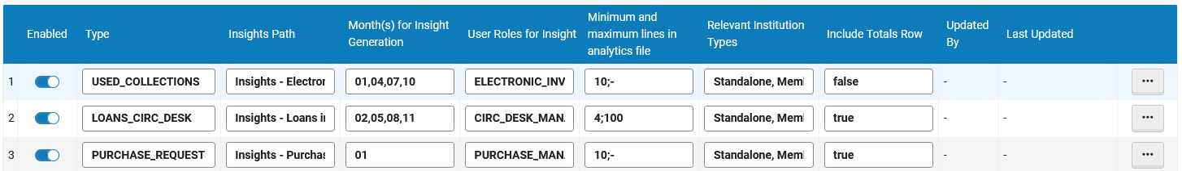
What's Going on Behind the Scenes
For our example we will look at type LOANS_CIRC_DESK

Slide 40
What's Going on Behind the Scenes
This is the Analytics report to be used (in this case “Insights - Loans in the Last 3 Months”
These are the months which the report will run
When calculating the total number of rows in the report include the row which has the total.
If the analytics report is more than 4 rows and less than 100 rows, then it will be used (otherwise it is deemed not appropriate to create an AI-Powered Insight)
This is the role (in this case Circ Desk Manager) which can view the AI-Powered Insight

Slide 41
What's Going on Behind the Scenes
Additionally, there is a hidden job called "Insights Generation Job".
It is scheduled to run once a week.
It will run once a week but only if that once a week also falls in one of the time frames defined in column "Month(s) for Insight Generation" which we previously saw in table "Insight Generation"
  The job runs weekly and checks the configuration. It generates insights that are configured to be generated this month.

Slide 42
Thank You

